Slide 1

Security Incident Log Automation Dashboard

Slide 2
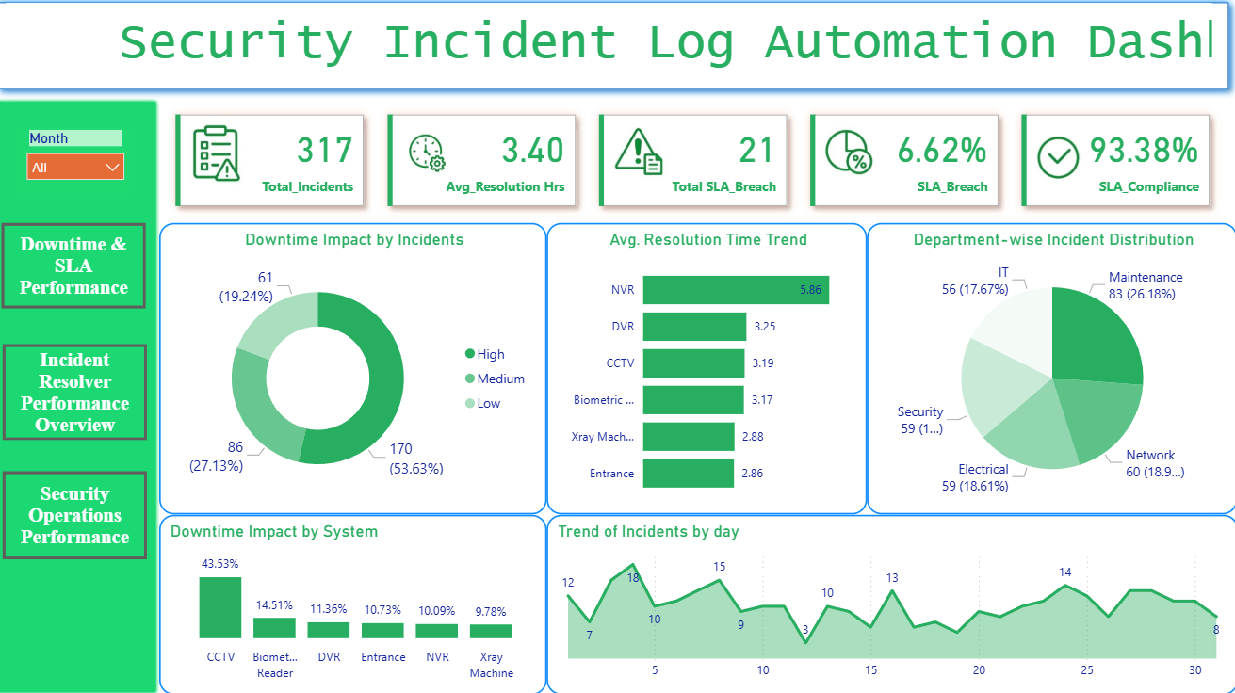

Slide 3
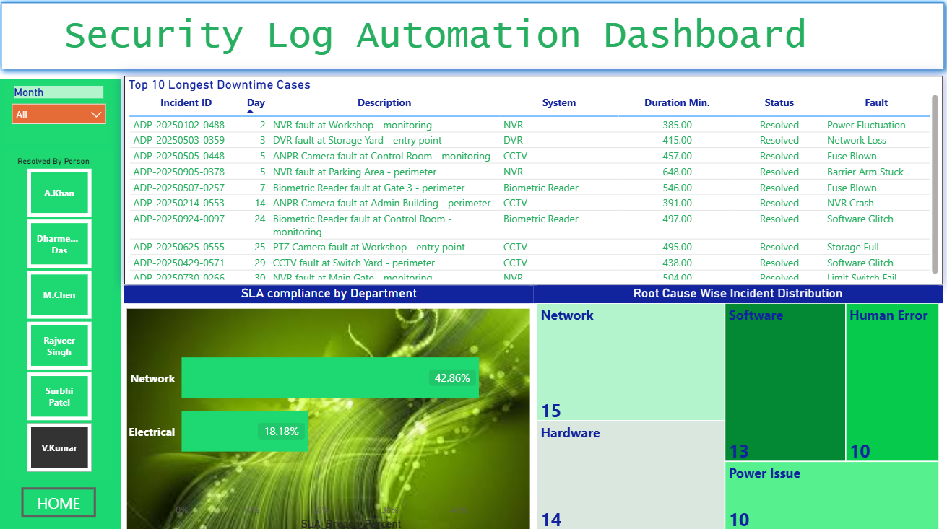

Slide 4
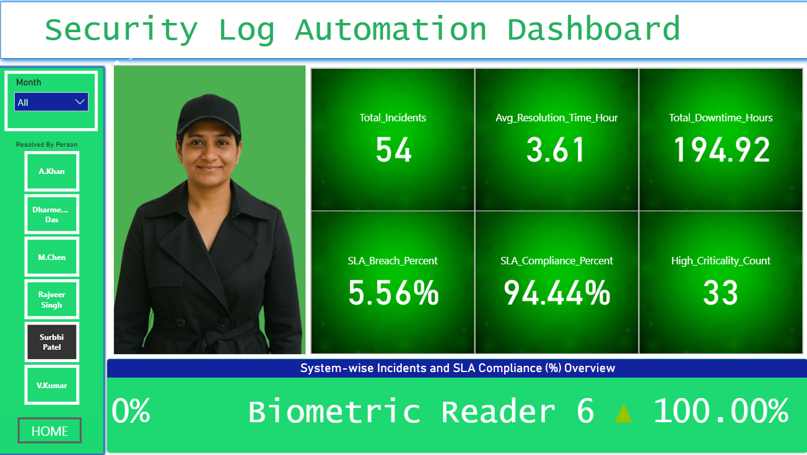

Slide 5
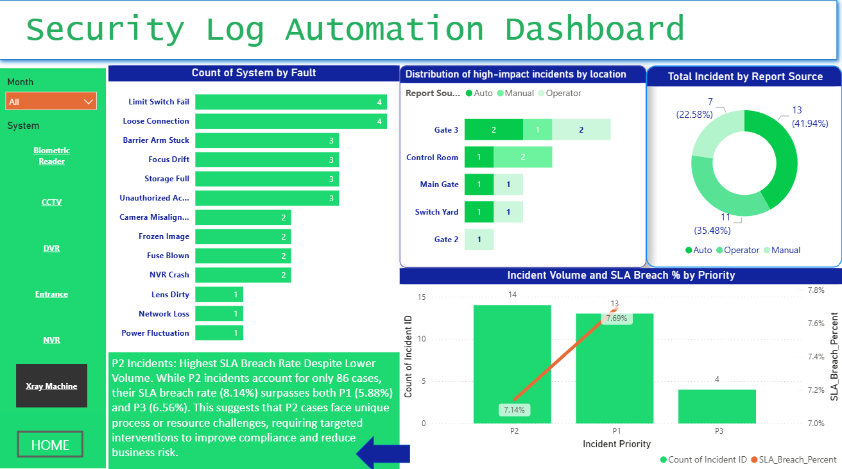

Slide 6
AI Insights & Recommendations
01 Chapter 1: Fault Distribution and Impact Analysis - Data Summary
  CCTV systems experience the highest fault rates, primarily due to image quality and optical issues such as Frozen Image, Focus Drift, and Lens Dirty, indicating a need for enhanced maintenance protocols.
  Electrical failures, notably Fuse Blown incidents, are predominant in Biometric Readers and NVR systems, underscoring the importance of robust power management and regular electrical inspections.
  Mechanical and network faults, including Limit Switch Fail, Barrier Arm Stuck, Network Loss, and NVR Crash, affect multiple systems and require cross-functional attention for improved reliability.
  The Control Room and Main Gate are identified as critical operational bottlenecks, with the highest average downtime impact and incident counts, making them priority areas for risk mitigation.
  Zones such as the HR Office and Parking Area present minimal downtime impact, suggesting limited potential for risk reduction and lower priority for resource allocation.
  Moderate-impact areas like the Admin Building, Storage Yard, and Workshop warrant secondary attention, with interventions prioritized based on incident frequency and impact.
  P2 incidents, despite lower volume, have the highest SLA breach rate, indicating unique process or resource challenges that require targeted compliance improvements.
  Manual reporting channels exhibit elevated SLA breach risk compared to automated sources, highlighting inefficiencies and the need for process optimization.

Slide 7
AI Insights & Recommendations
Resolution Performance and Root Cause Analysis: Data Summary
  The Electrical department exhibits the longest average incident resolution time (243.9 minutes), indicating process inefficiencies compared to Security (160.7 minutes).
  Maintenance department leads in SLA compliance, resolving 83 incidents within SLA, significantly outperforming other departments (56–60 incidents).
  Security achieves the fastest resolution times, while Maintenance excels in SLA adherence, highlighting a trade-off between speed and quality.
  Software and human error incidents show high volatility, with notable monthly spikes, representing key operational risks.
  Power-related incidents display seasonal peaks, suggesting underlying infrastructure vulnerabilities that require attention.
  Hardware incident frequency remains stable, but software incidents are rising, reflecting increased reliance on software systems.
  Top performers (V.Kumar, Rajveer Singh, Surbhi Patel) account for a substantial share of incident resolutions, indicating potential for peer-led process improvement.
  Resolution time varies significantly among staff, with a 30.72-minute gap between the fastest (M.Chen) and slowest (Surbhi Patel) resolvers, highlighting efficiency improvement opportunities.

Slide 8
AI Report Summary
01 Incident Resolution Data Analysis - Professional Summary
  CCTV systems exhibit the highest fault rates, primarily due to image quality and optical issues, necessitating improved maintenance protocols.
  Electrical failures, especially Fuse Blown incidents, are most prevalent in Biometric Readers and NVR systems, highlighting the need for robust power management.
  Mechanical and network faults impact multiple systems, requiring cross-functional attention for enhanced reliability.
  The Control Room and Main Gate are critical operational bottlenecks with the highest downtime and incident counts, making them priority areas for risk mitigation.
  Low-impact zones such as the HR Office and Parking Area present minimal downtime, suggesting lower priority for resource allocation.
  Moderate-impact areas like the Admin Building, Storage Yard, and Workshop warrant secondary attention based on incident frequency and impact.
  P2 incidents have the highest SLA breach rate despite lower volume, indicating unique process challenges needing targeted compliance improvements.
  Manual reporting channels show elevated SLA breach risk compared to automated sources, highlighting inefficiencies in current processes.

